Slide 1
COMMENTING RESPECTFULLY
Level 1: Digital Citizenship
Lesson 12

Slide 2
QUESTION:
Have you ever commented on someone else’s post?
Has anyone ever commented on something you’ve posted?
Have you ever seen (or heard about) people posting comments that are hurtful, rude, inappropriate, or untrue?

Slide 3
All the people and sites you follow (or will follow), all the content you post, like or share, and all the comments you make, contribute to your digital reputation.

Slide 4
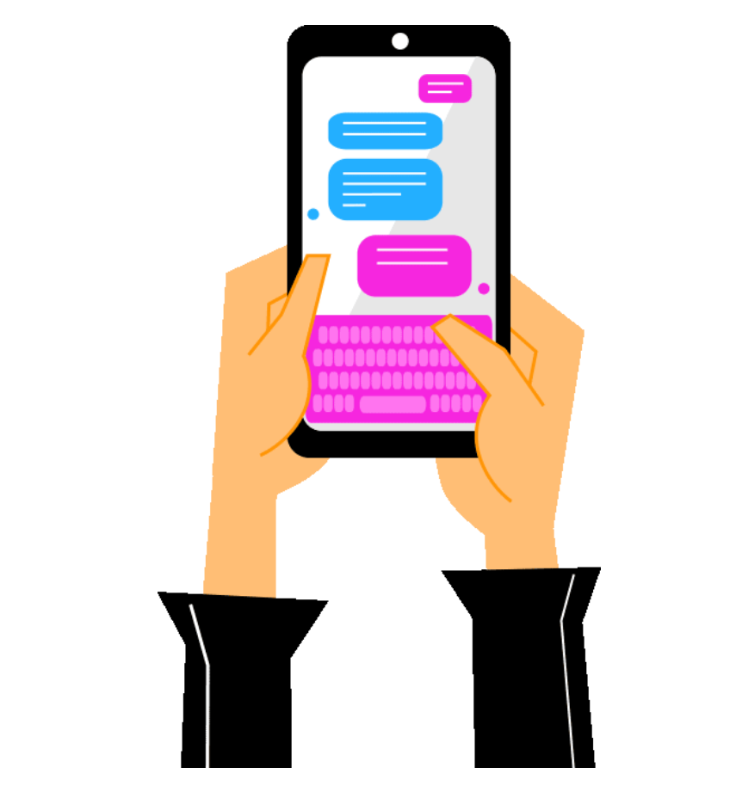
Treats others with respect.
Seeks to understand before commenting.
Celebrates another's accomplishments.
Uses appropriate language.
Comments positively, without criticism. If they disagree, they politely state their perspective.
Asks questions with the hope of continuing a conversation and deepening thinking.
Triple checks before submitting any comment and asks themselves: Would you be happy to have your mother read this? What about your teacher?
A RESPECTFUL COMMENTOR:

Slide 5
ACTIVITY

Slide 6
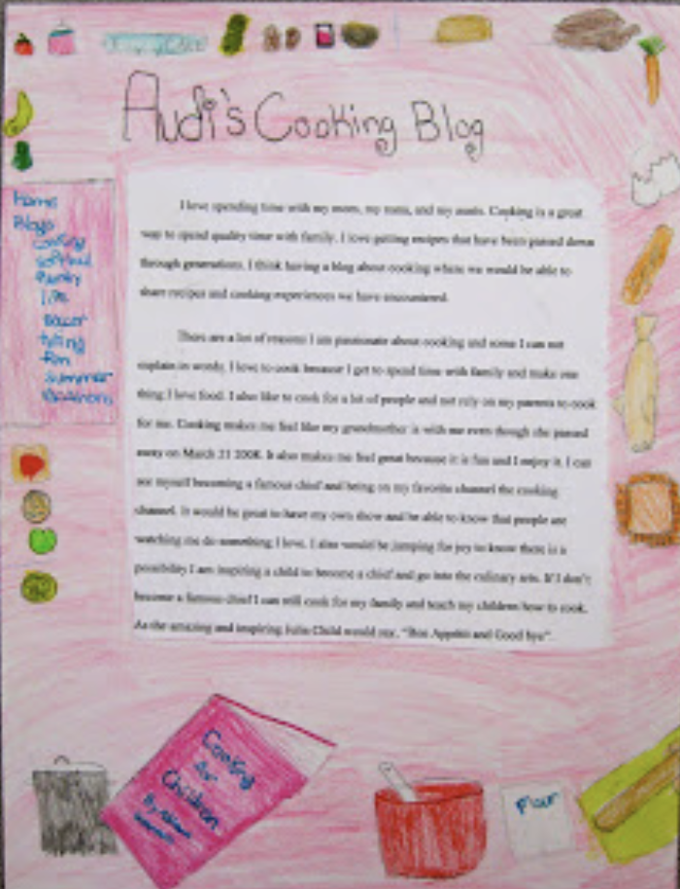
ACTIVITY (PART 1):
Think of something you’re passionate about… a favorite sport or hobby, or a topic like climate change or world hunger.
Imagine a post about this topic. This could be an image, a video, a blog post, a meme, or just about anything.
On your blank sheet of paper or card illustrate the post you just imagined (for example, if it is a video, draw the visuals that appear and describe them).
Make your post visually pleasing (see example).

Slide 7
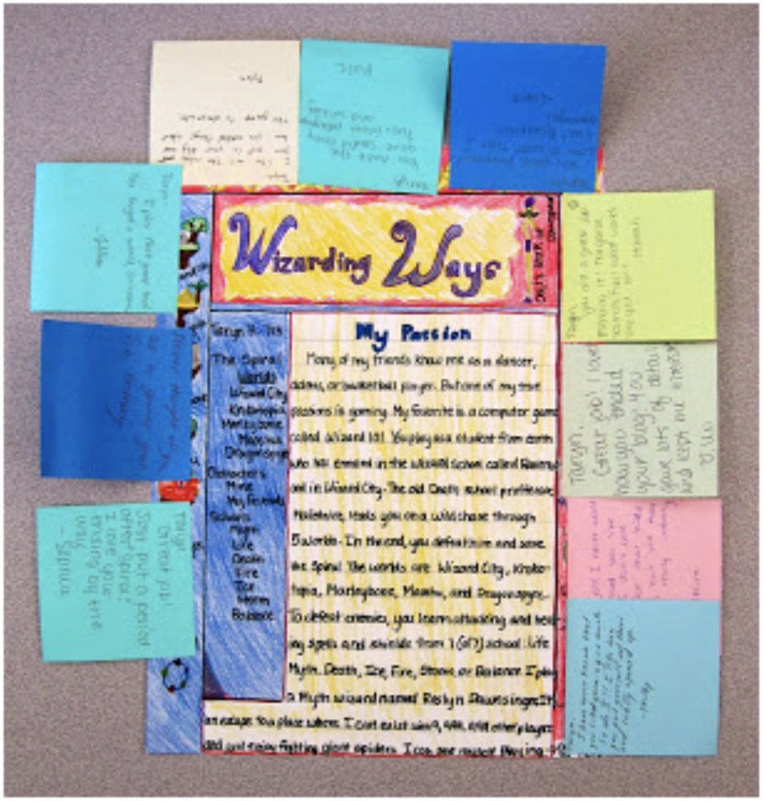
ACTIVITY (PART 2):
Use the “Post-It” notes to “post” your comments.
Take 5-10 minutes to look at, read, reflect, and comment on each post.
Do this silently (this is not an activity for discussion).
Look at and read each post thoroughly.
Read and respond to any previous comments.

