Slide 1
WHEN FACETUNE GOES TOO FAR
Level 3: Media Literacy for Positive Participation
Lesson 16

Slide 2
DISCUSS:
How did you answer these questions from your previous lesson?
Do you think Instagram should have flagged that particular image as “false”? Why or why not?
In general, do you think Instagram is doing the right thing flagging false information? Explain.
If you worked at a social media company, what would your criteria be for alerting users to false information?

Slide 3
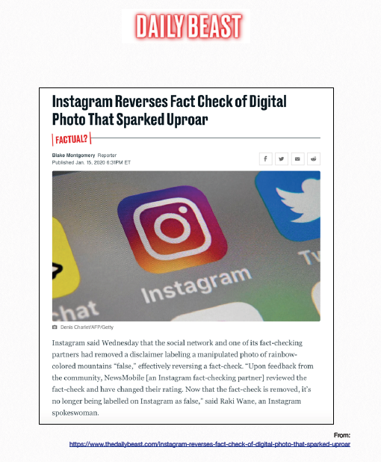
Guess What? Instagram reversed its decision.
Read about it Here: https://www.thedailybeast.com/instagram-reverses-fact-check-of-digital-photo-that-sparked-uproar

Slide 4
While there are many reasons why photos are altered, one of the most concerning and more popular trends is the altering of our own self-images. This is partly due to the ubiquity of selfies and because photo-editing apps like Facetune make it so easy to do.

Slide 5
SELF-IMAGE
Self-image is influenced by a variety of factors, and media plays an important role in how we view ourselves.
“Media” includes what we read/see in social media posts, videos, and more.
In some extreme cases, unrealistic body portrayals in media have led to the development of eating disorders or the seeking out of plastic surgery in both males and females.

Slide 6
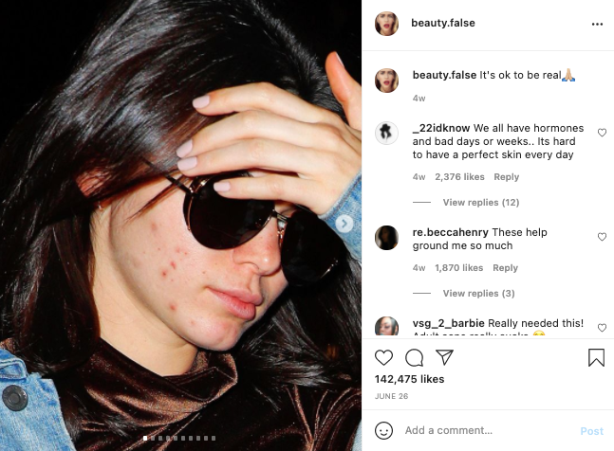
“EDITED TO PERFECTION”
Celebrities and other influencers are using social media to voice concern about being “edited to perfection.”
On Instagram there is a large community of anti-Facetuners. Popular accounts such as @s0cialmediavsreality and @beauty.false are pulling back the curtain on how widespread this kind of editing is.
There are laws combatting this too. Norway now requires influencers and advertisers to label retouched images on social media. Their law is intended to fight against unrealistic depictions of beauty and health.

Slide 7
ACTIVITY

Slide 8
WHAT DO YOU THINK?
Gather in groups of 3-4 (mixed genders, if possible) to read and discuss the article your teacher gives you. Afterwards, have a class discussion about the questions:
In general, how did your group feel about the use of editing software like Facetune?
What did your group think about this excerpt from the article: “Facetune makes it harder for her to love herself, but at least she can love her selfie”?
Did your group think males are impacted by seeing perfect images of other males online?

Slide 9
WHAT DO YOU THINK?
The article mentioned that “Instagram’s Explore feed is algorithmically curated to show users more of what they already look at, whether it’s puppies, vegan meal plans or picture-perfect influencers. The result is an echo chamber...” What did your group think about this feature?
What did your group think about the new law in Norway that requires influencers and advertisers to label retouched images on social media? Did your group think other countries should enact similar laws?

